Slide 1
e-Commerce Data Analysis Project
Project by: Madhuri Hawaldar

Slide 2
Project Overview:
Objective:
To analyze e-commerce data and extract actionable business insights to improve:
Revenue growth
Customer retension
Product performance
Seller performance
Tools Used:
MySQL (Data Extraction and Analysis)
Python (Data cleaning and Visualization)

Slide 3
Dataset Overview:
Dataset Files:
customers.csv: Customers demographic details
Sellers.csv: Sellers information
Orders.csv: Order history and details
Order_items.csv: Order items details
Products.csv: products details
Payments.csv: Payments details
Geolocation.csv: Geolocation details

Slide 4
Data Cleaning Steps:
Handled missing values
Converted Date columns to proper format
Removed duplicate records
Joined multiple tables using LEFT JOIN

Slide 5
Key Business KPIs
Total Customers
95128
Total Orders
95128
Total Sellers
2914
Total Revenue
15898189

Slide 6
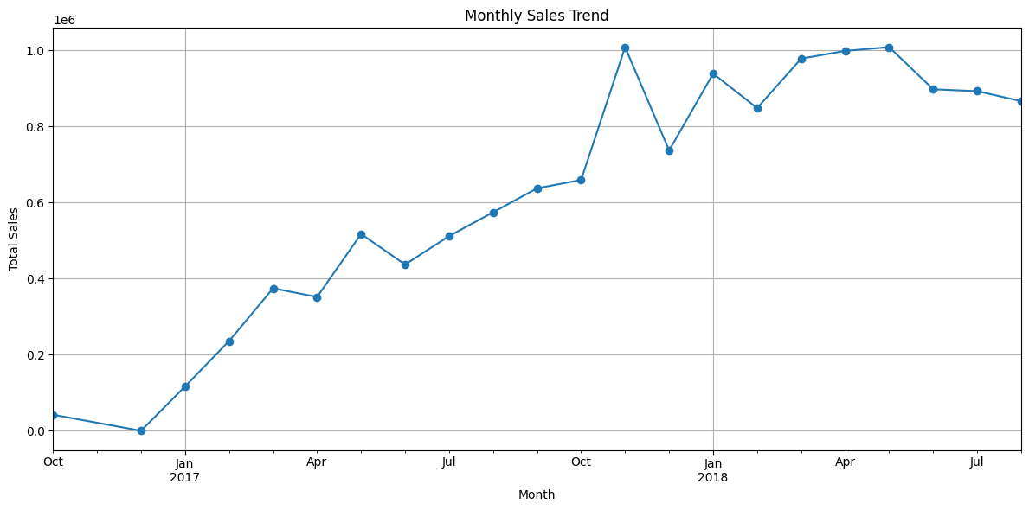
Monthly Sales Trend Analysis:
Key Insights :
Steady growth from late 2016 through mid-2018
Major peak in October 2017, likely seasonal or promotional.
Sales remain elevated after the peak, showing sustained demand.

Slide 7
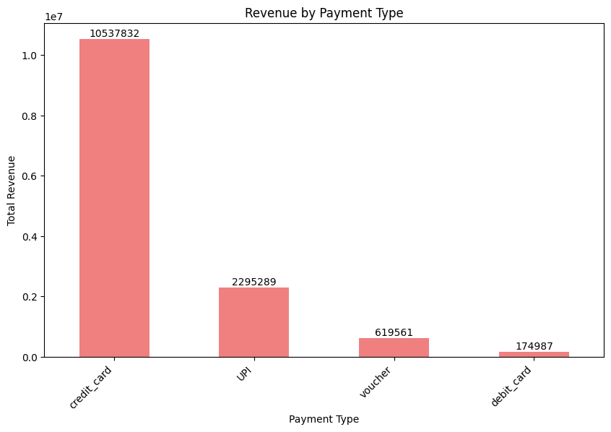
Revenue by Payment type Analysis
Key Insights:
Credit Cards dominate: Contribute 10.5M revenue, accounting for the majority share.
UPI is growing: At 2.3M, it’s the second-largest method, showing strong adoption but still far behind credit cards.
Vouchers are niche: Generate 619K, likely tied to promotions or loyalty programs.
Debit Cards underperform: Only 175K, indicating very low customer preference.

Slide 8
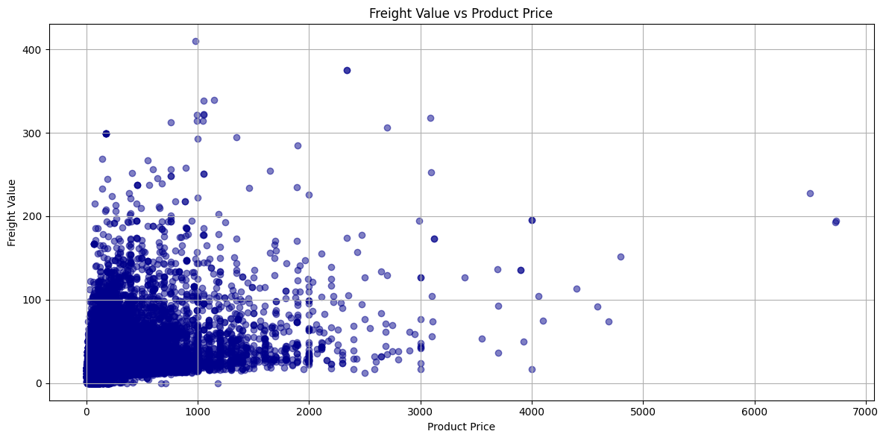
Freight Value v/s Product Price
Key Insights:
Cluster at low values: Most products have low prices and low freight costs, showing that the bulk of business is concentrated in the lower range.
Positive correlation: As product price increases, freight value tends to rise too—indicating higher-priced items often incur higher shipping costs.
Outliers matter: A few products with very high prices and freight values stand out. These could represent premium goods or bulky shipments that disproportionately affect logistics.

Slide 9
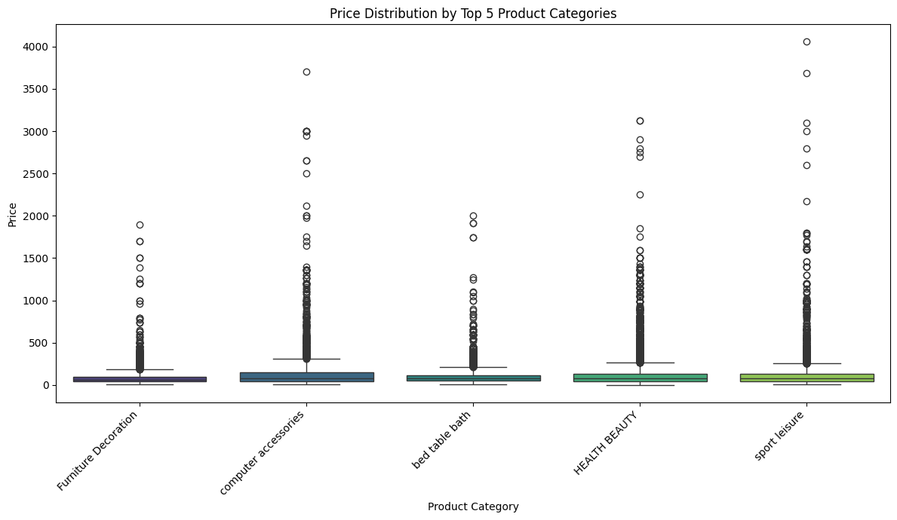
Price distribution by top 5 product categories
Key Insights:
Furniture Decoration: widest price range, premium outliers.
Computer Accessories & Health Beauty: lowest, most stable prices.
Bed Table Bath: mid-range, balanced distribution.
Sport Leisure: mix of affordable and premium items.

Slide 10
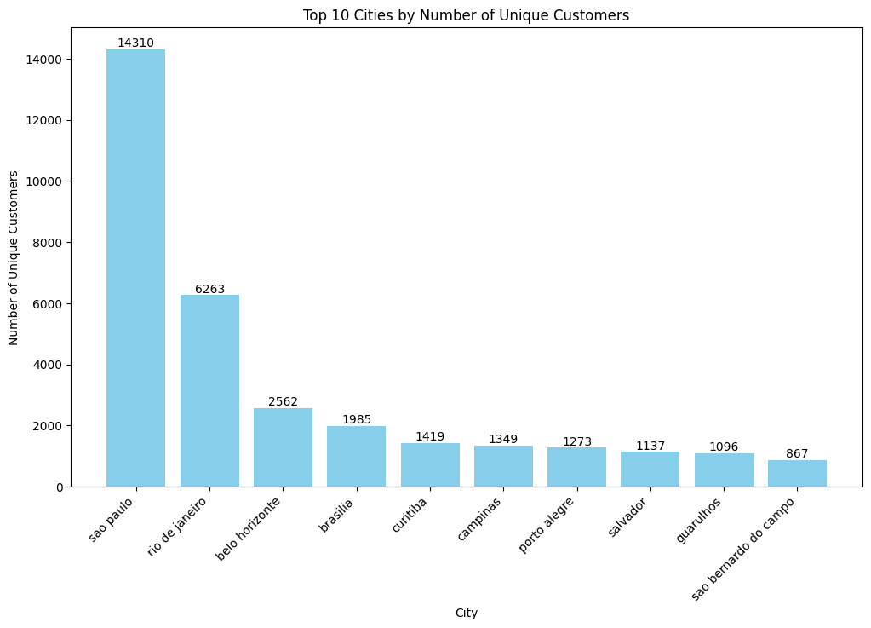
Top 10 Cities by Sales
Key Insights:
Sao Paulo dominates with 14,310 customers — more than double Rio de Janeiro.
Rio de Janeiro is second (6,263), showing strong but significantly smaller base.
Belo Horizonte, Brasilia, Curitiba form the mid-tier (1,400–2,500 customers).
Campinas, Porto Alegre, Salvador, Guarulhos, Sao Bernardo do Campo each have ~900–1,300 customers, representing smaller but notable markets.
Clear concentration in major urban hubs, with Sao Paulo as the primary driver.

Slide 11
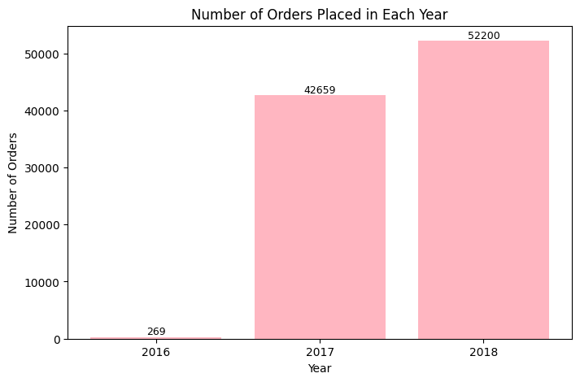
Order Analysis Per Year
Key Insights:
2016: Very low activity (269 orders).
2017: Explosive growth to 42,659 orders.
2018: Continued strong growth, reaching 52,200 orders.
Growth from 2016 to 2018 is nearly 200x, showing rapid business expansion.
Momentum is sustained, with 2018 surpassing 2017 by ~22%.

Slide 12
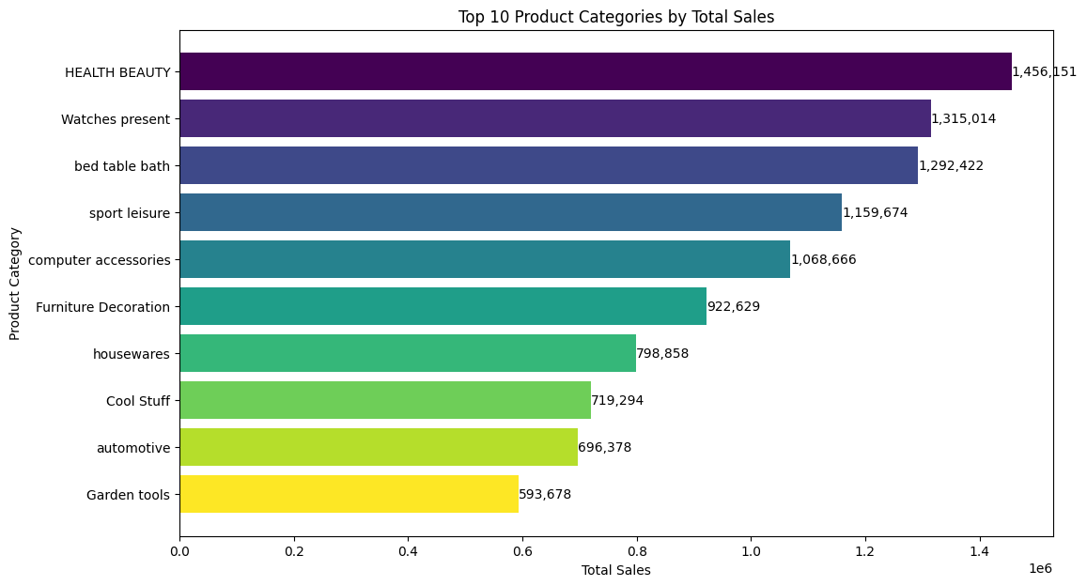
Total Sales per Category
Key Insights:
Health Beauty leads with the highest sales (1.46M), showing strong customer demand.
Watches Present and Bed Table Bath follow closely, both above 1.29M, forming the next tier of high-performing categories.
Sport Leisure and Computer Accessories also cross the 1M mark, indicating solid revenue streams.
Furniture Decoration and Housewares sit in the mid-range (0.8–0.9M).
Cool Stuff, Automotive, and Garden Tools round out the list, each contributing ~0.6–0.7M.

Slide 13
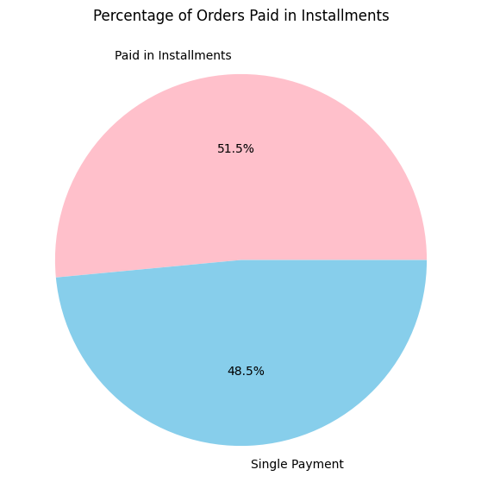
Orders Paid in Installment
Key Insights:
Installments slightly dominate: 51.5% of orders are paid in installments.
Single payments remain strong: 48.5% of customers prefer paying upfront.
The split is almost even, showing diverse payment preferences.
Indicates that flexible payment options are crucial to meet customer needs.

Slide 14
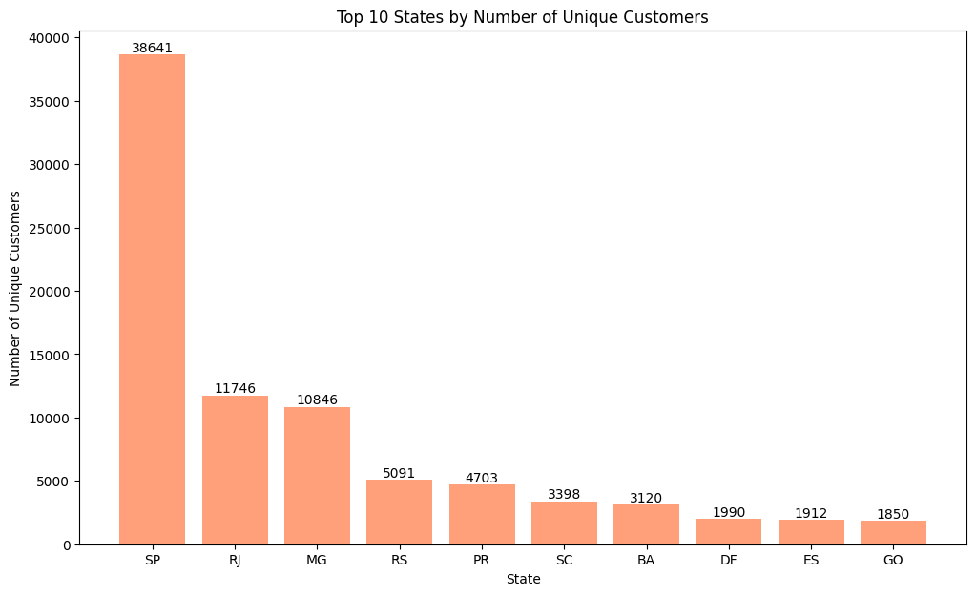
Number of Customers From each State
Key Insights:
São Paulo (SP) dominates with 38,641 customers, far ahead of all other states.
Rio de Janeiro (RJ) and Minas Gerais (MG) form the second tier, each with ~11K customers.
Rio Grande do Sul (RS) and Paraná (PR) follow, with ~5K and ~4.7K customers respectively.
Santa Catarina (SC), Bahia (BA), Distrito Federal (DF), Espírito Santo (ES), and Goiás (GO) contribute smaller but notable bases (1.8K–3.4K).
Clear concentration in SP, accounting for the majority of customers compared to other states.

Slide 15
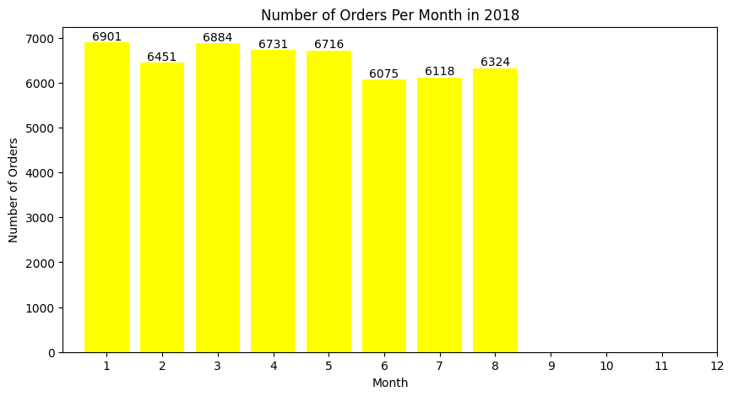
Number of Orders per Month in 2018
Key Insights:
Strong start to the year: January (6,901) and March (6,884) were peak months.
Stable performance: February, April, and May all maintained ~6,400–6,700 orders.
Mid-year dip: June (6,075) and July (6,118) saw the lowest volumes.
Recovery in August: Orders rose slightly to 6,324.
Overall, monthly orders stayed consistently between 6K–7K, showing steady demand with minor seasonal fluctuations.

Slide 16
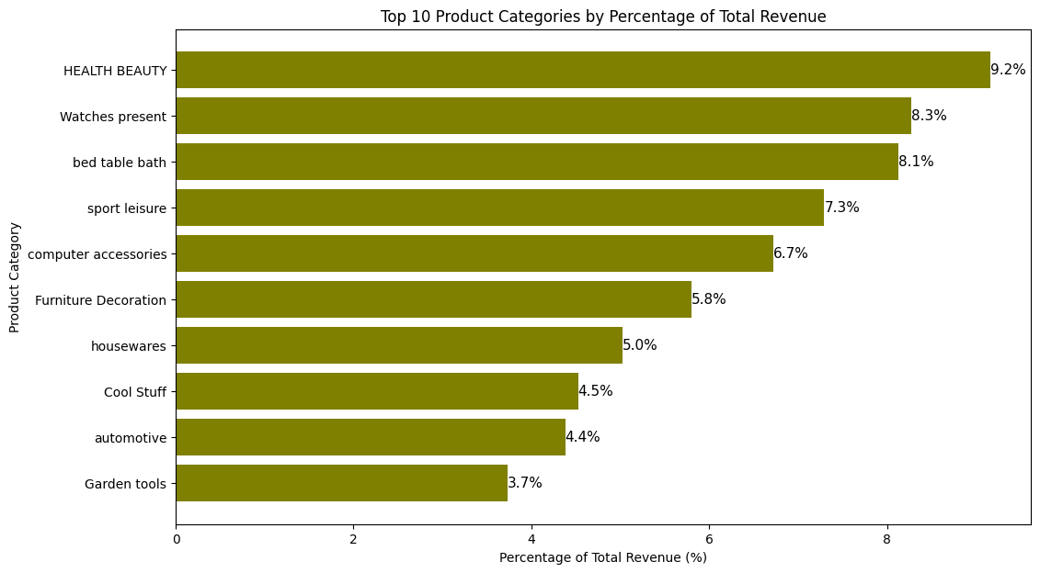
Top 10 Product Categories by Revenue
Key Insights:
Health Beauty leads with 9.2%, the single largest contributor to revenue.
Watches Present (8.3%) and Bed Table Bath (8.1%) form the next strong tier.
Sport Leisure (7.3%) and Computer Accessories (6.7%) also contribute significantly.
Furniture Decoration and Housewares add mid-level shares (5–6%).
Cool Stuff, Automotive, and Garden Tools contribute smaller portions (3.7–4.5%).
The top 5 categories together account for nearly 40% of total revenue, showing clear concentration.

Slide 17
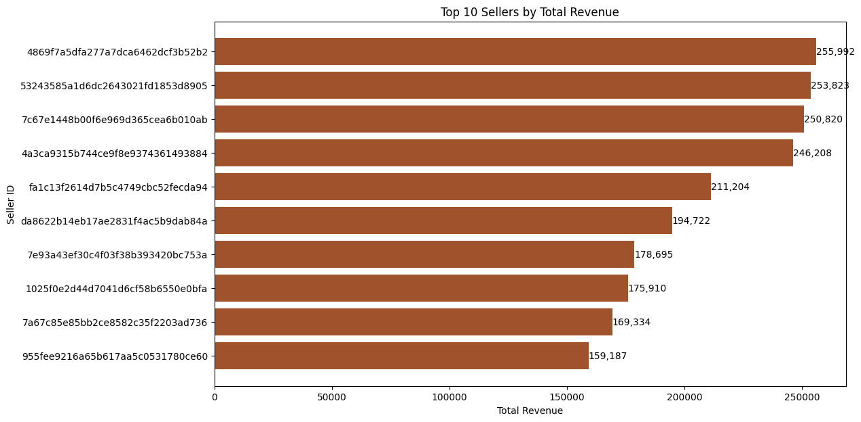
Top 10 Sellers by Revenue
Key Insights:
The top 4 sellers (IDs ending in b2, 905, 0ab, 884) are tightly clustered, each generating between 246K–256K. This suggests a highly competitive tier at the top.
There’s a noticeable drop-off after the 4th seller: Seller fa1c13f... at 211K is about 35K lower than the 4th place, marking a clear gap between the leaders and the rest.
The bottom 3 sellers (IDs ending in 753a, 0bfa, 736, e60) range between 159K–178K, showing a smaller spread compared to the top tier.

Slide 18
Conclusion
Customer Demographics and Spending Patterns: São Paulo (SP) is the primary customer hub, leading in unique customers across cities and states. Most orders consist of a single item, with variations in average items per order across different cities. Credit Card is the most preferred payment method and generates the highest revenue, with approximately 51.5% of orders utilizing installment payments.
Key Performance Indicators (KPIs): Monthly sales show an upward trend from late 2016 to mid-2018, with seasonal peaks. 2018 recorded the highest order volume. The vast majority of orders were successfully delivered, indicating efficient fulfillment, with a minimal number of cancellations. The average delivery time is around 12 days, and most orders fall into lower price ranges.
Product and Seller Performance: 'HEALTH BEAUTY', 'Watches present', and 'bed table bath' are consistently the top product categories by total sales and revenue percentage. There is a very weak negative correlation (-0.03) between product price and the number of purchases, suggesting price is not the sole driver of purchase frequency. Specific seller IDs were identified as high-revenue generators.

Slide 19
Resources:
Data extraction and analysis:
Tool: MySQL Workbench
File: Link
Data Cleaning, Analysis and Visualization:
Tool: Pandas, Matplotlib
File: Link

